Slide 1
Seven Qualities of a Good Leader

Slide 2
1. A good leader has an exemplary character. It is of utmost importance that a leader is trustworthy to lead others. A leader needs to be trusted and be known to live their life with honestly and integrity. A good leader “walks the talk” and in doing so earns the right to have responsibility for others. True authority is born from respect for the good character and trustworthiness of the person who leads.
Notes:
Who would have this quality?

Slide 3
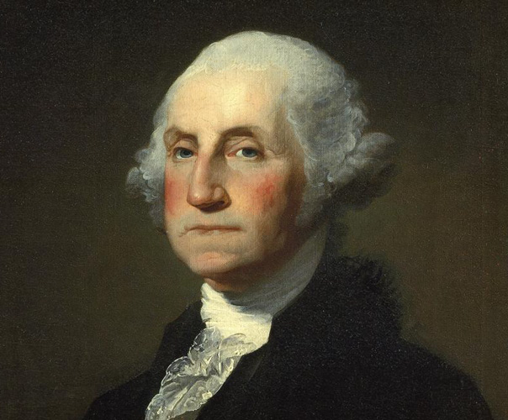

Slide 4
2. A good leader is enthusiastic about their work or cause and also about their role as leader. People will respond more openly to a person of passion and dedication. Leaders need to be able to be a source of inspiration, and be a motivator towards the required action or cause. Although the responsibilities and roles of a leader may be different, the leader needs to be seen to be part of the team working towards the goal. This kind of leader will not be afraid to roll up their sleeves and get dirty.

Slide 5
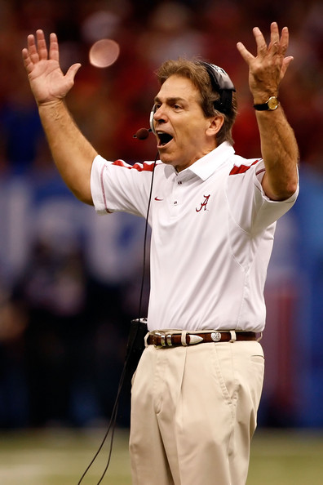

Slide 6
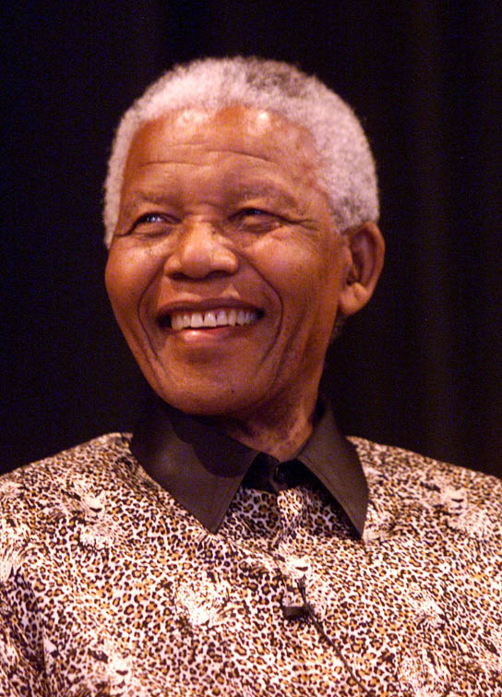
3. A good leader is confident. In order to lead and set direction a leader needs to appear confident as a person and in the leadership role. Such a person inspires confidence in others and draws out the trust and best efforts of the team to complete the task well. A leader who conveys confidence towards the proposed objective inspires the best effort from team members.

Slide 7
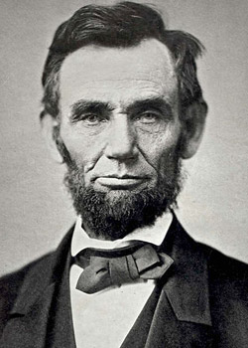
4. A leader also needs to function in an orderly and purposeful manner in situations of uncertainty. People look to the leader during times of uncertainty and unfamiliarity and find reassurance and security when the leader portrays confidence and a positive demeanor.

Slide 8
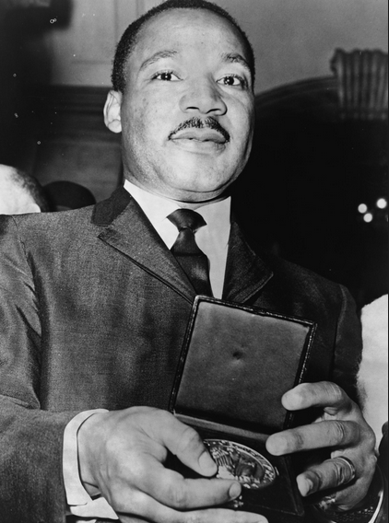
5. Good leaders are tolerant of ambiguity and remain calm, composed and steadfast to the main purpose. Storms, emotions, and crises come and go and a good leader takes these as part of the journey and keeps a cool head.

Slide 9
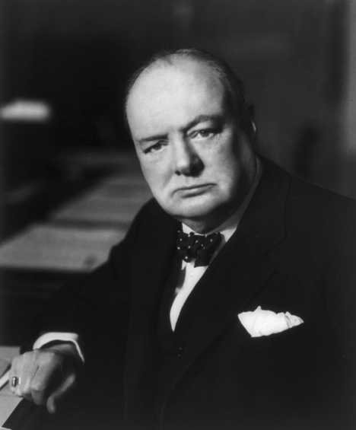
6. A good leader as well as keeping the main goal in focus is able to think analytically. Not only does a good leader view a situation as a whole, but is able to break it down into sub parts for closer inspection. Not only is the goal in view but a good leader can break it down into manageable steps and make progress towards it.

Slide 10
7. A good leader is committed to excellence. Second best does not lead to success. The good leader not only maintains high standards, but also is proactive in raising the bar in order to achieve excellence in all areas.

Slide 11
These seven personal characteristics are foundational to good leadership.
Some characteristics may be more naturally present in the personality of a leader.
However, each of these characteristics can also be developed and strengthened.
A good leader whether they naturally possess these qualities or not, will be diligent to consistently develop and strengthen them in their leadership role.

Slide 12
Notes:
This is what a leader’s flowchart looks like.

Slide 13
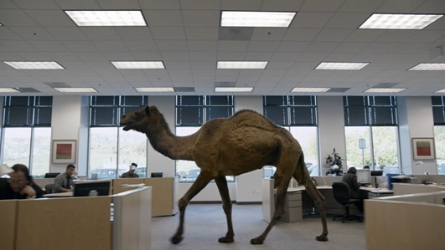
That’s All!

